Slide 1

Artificial Life
Ajit Babu
12/April/2022

Slide 2

Definition
A field of study wherein researchers examine systems related to natural life, its processes, and its evolution, through the use of simulations with computer models, robotics, and biochemistry.
Artificial life became a recognized discipline in the 1980s.
Christopher Langton(American computer scientist) named the field 'Artificial Life'.

Slide 3


About the Term A-life
Christopher Langton in 1987 organized the first International Conference on the Synthesis and Simulation of Living Systems and characterized artificial life as “locating life-as-we-know-it within the larger picture of life-as-it-could-be.”
A concept that brought together people interested in computer models of adaptive and self-organizing systems, not just in biology but also in economics, social science, and physical chemistry.

Slide 4

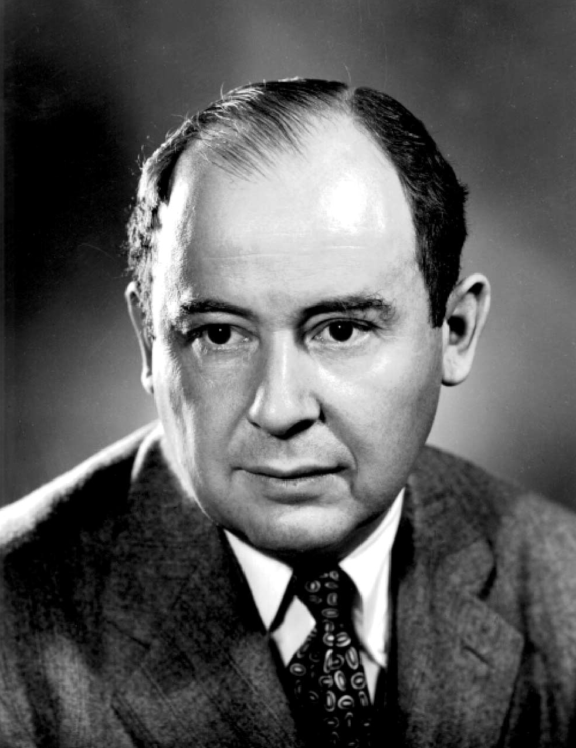
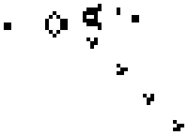
Few more details

Slide 5

The beginning
This field of research begins with a fundamental non-banal question: what is life? And, more concretely, how can we create life? In other words, it actually strives to become a god-like creator.
And, notably, while the today’s fashionable Artificial intelligence (AI) is traditionally using a top-down approach – to engineer human-like ‘intelligence’ – artificial life generally works from the bottom-up, that is to create life – and eventually intelligence – from scratch.

Slide 6

basic approaches
The strong a-life position states that life is a process which can be abstracted away from any particular medium, and the weak a-life position denies the possibility of generating a “living process” outside of a chemical solution and, instead, tries to simulate life processes to understand the underlying mechanics of biological phenomena.
A-life can be hardware-, software- or chemical-based. Hardware is, essentially, robots, software are computer simulations and chemical-based is synthetic biology.

Slide 7

Software based
Implementing evolving systems in software is the most practical and constructive way to study many issues about evolving systems, and this “soft” approach has been a dominant trend in artificial life.
One of the first significant achievement of spontaneous evolution in a digital medium was Tierra, developed by ecologist Thomas S. Ray.
Techniques:
Cellular automaton
Artificial neural networks
Neuroevolution

Slide 8

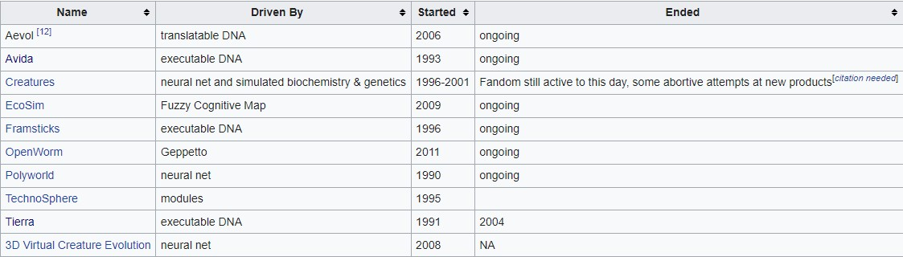
list of artificial life simulators

Slide 9

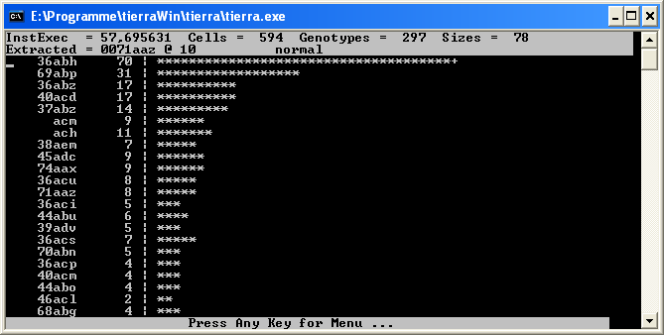
Tierra
A computer simulation in which computer programs compete for time and space.
The computer programs in Tierra are considered to be evolvable and can mutate, self-replicate and recombine.
Tierra's virtual machine is written in C.
It operates on a custom instruction set designed to facilitate code changes and reordering, including features such as jump to template.

Slide 10

Different simulations
Program-based - contain entity with a complex DNA language, language is more often in the form of a computer program than actual biological DNA. Assembly derivatives are the most common languages used. An organism "lives" when its code is executed, and there are usually various methods allowing self-replication. Mutations are generally implemented as random changes to the code.
Module-based - Individual modules are added to a creature. These modules modify the creature's behaviors and characteristics either directly, by hard coding into the simulation (leg type A increases speed and metabolism), or indirectly, through the emergent interactions between a creature's modules.
Parameter-based - Entity are generally constructed with pre-defined and fixed behaviors that are controlled by various parameters that mutate. That is, each organism contains a collection of numbers or other finite parameters. Each parameter controls one or several aspects of an organism in a well-defined way.
Neural net–based - Have creatures that learn and grow using neural nets or a close derivative. Emphasis is often, although not always, on learning rather than on natural selection.

Slide 11

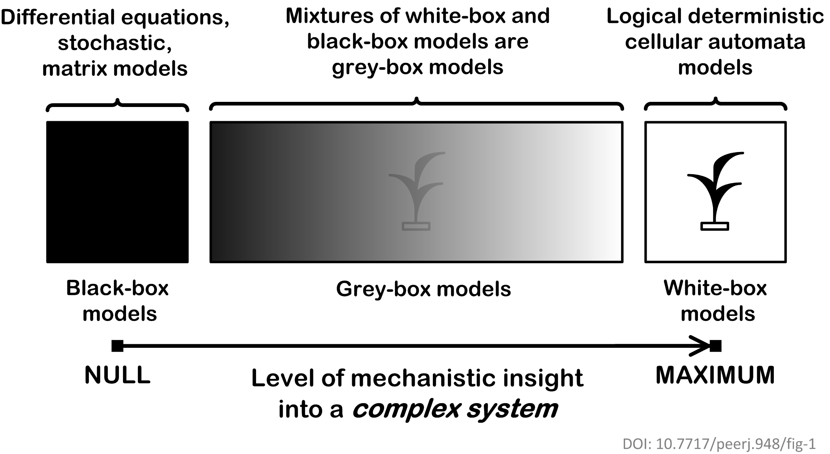
Complex systems modelling
Mathematical models of complex systems are of three types: black-box (phenomenological), white-box (mechanistic, based on the first principles) and grey-box (mixtures of phenomenological and mechanistic models).
In black-box models, the individual-based (mechanistic) mechanisms of a complex dynamic system remain hidden. Black-box models are completely nonmechanistic. They are phenomenological and ignore a composition and internal structure of a complex system. Due to the non-transparent nature of the model, interactions of subsystems cannot be investigated.
In contrast, a white-box model of a complex dynamic system has ‘transparent walls’ and directly shows underlying mechanisms. All events at the micro-, meso- and macro-levels of a dynamic system are directly visible at all stages of a white-box model's evolution. In most cases, mathematical modelers use the heavy black-box mathematical methods, which cannot produce mechanistic models of complex dynamic systems.
Grey-box models are intermediate and combine black-box and white-box approaches.

Slide 12

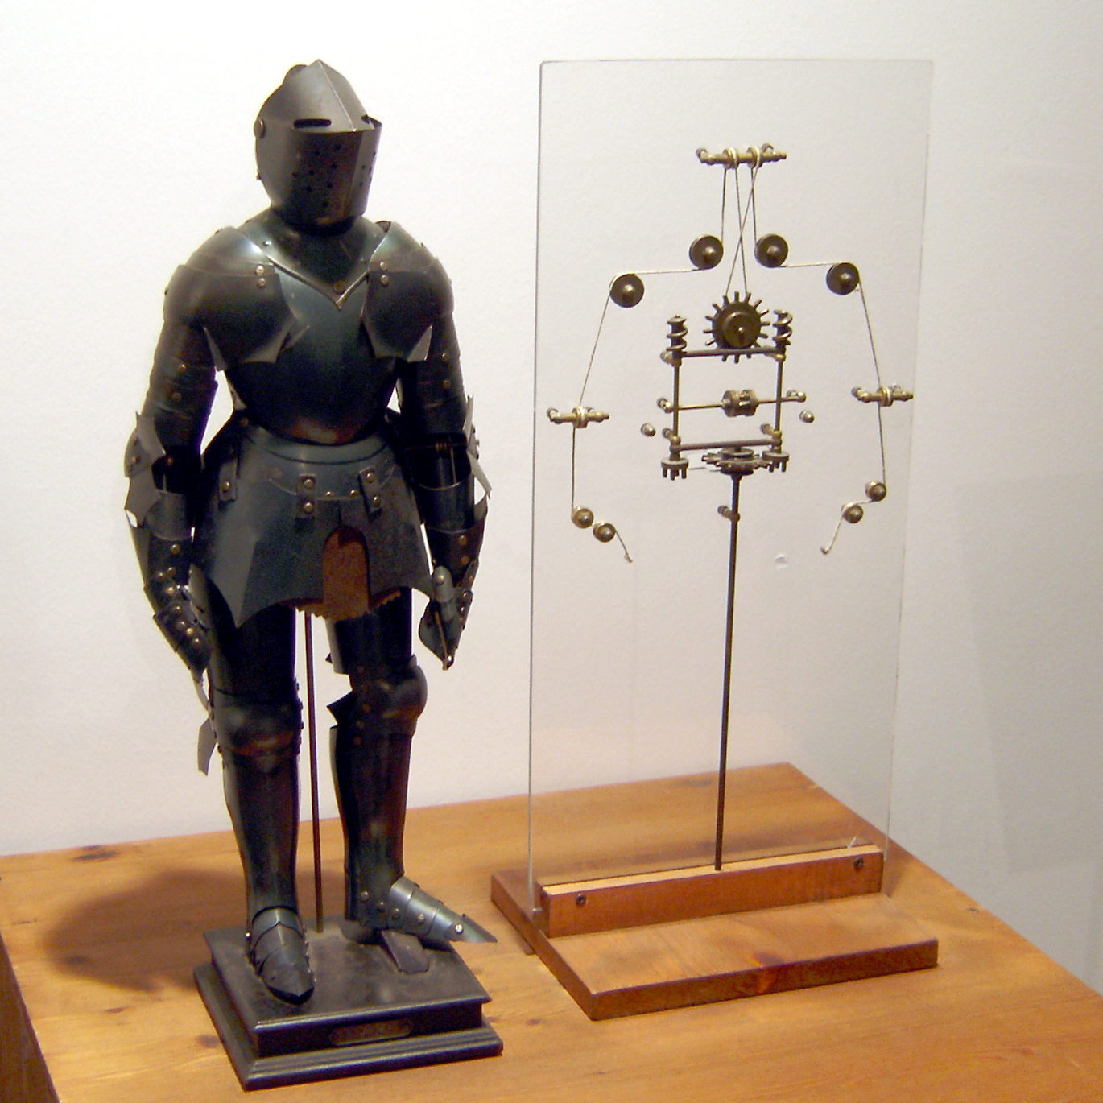
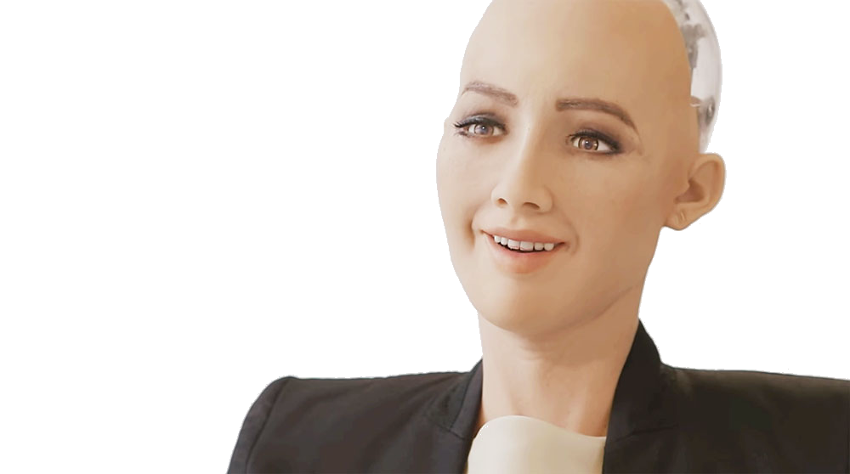
Hardware-based
Hardware-based artificial life mainly consist of robots, that is, automatically guided machines able to do tasks on their own.
From ancient mythologies, like the famous golems of Jewish legend and the mythical statue of Pygmalion, until Leonardo’s automaton, the idea of humanoid robots always triggered mankind’s imagination.
As of now, AI is providing to robots intelligence. Results are definitely creepy. One of the creepiest is Sophia, a robot whom Saudi Arabia famously gave citizenship in 2017.
Finally, it is also true that we will use to meet AI not only through software, but also through weird robot shapes, and very rarely through humanoid shapes.

Slide 13


“Nothing can suppress a human’s curiosity.” - Eren Jaeger

